Slide 1

Credit Risk
Basics
Javier Azores
BODIAN LI

Slide 2


Guideline
Introduction of Credit Risk
Credit Risk Measurement
Credit Risk Management

Slide 3


Introduction
Of Credit Risk

Slide 4

Introduction of Credit Risk
Credit Risk Definition
Retail Credit Risk
Commercial Credit Risk
Credit Risk Variables

Slide 5
Credit Risk
Definition

Slide 6

Risk Definition
Risk
Variability of adverse outcomes that are unexpected: potential unexpected losses
Risk vs Uncertainty
Some authors and practitioner differentiate between risk and uncertainty. Risk is quantifiable, uncertainty is not.
Risk Quantifiable Highly controlled environment Known set of outcomes Relevant past info Possibility to calculate probabilities Simple systems
Uncertainty Not quantifiable
Unknown event or unknown outcomes Known outcomes with no relevant past info Events with heavy-tailed distributions (rare extreme outcomes) Non-linear complex systems

Slide 7
Credit Risk Definition
Oldest type of financial risk
Economic loss from the failure of a counterparty to fulfill its contractual obligations or from the increased risk of the counterparty of doing so
Several ways to split in sub-risks:
Default (debt obligations)
Downgrade/migration in credit quality
Settlement risk

Slide 8
Retail
Credit Risk

Slide 9
Retail Credit Risk
Types of products: Home mortgages, Credit Cards, Auto loans, Student loans, Home Equity loans, etc.
Large number of small, low-value loans
Less concentration and correlation risk
Credit Scoring models: statistical procedure to analyze (objective and subjective) borrower’s info to assess its capacity and willingness to repay debt:
Basel accords require banks to segment their retail portfolio into sub-portfolios with similar behavior (loss and prepayment characteristics)
FICO used in USA and Canada
Banks have their own internal model as well

Slide 10
Commercial Credit Risk

Slide 11
Commercial Credit Risk
Type of products: Business loans or Lines of Credit, Commercial mortgage, Letters of Credit, Bonds, inverse REPOs, Derivative contracts, etc.
Large exposure to single names
Higher concentration and correlation risk
Credit Rating: external credit assessment by independent Agencies (S&P, Moody’s, Fitch, etc.). Credit risk evaluation process asks about four main points:
High impact of migration risk in trading book products
Obligor’s capacity and willingness to repay (liquidity, free cash flow generation, asset quality)
External environment (systemic risk, country risk)
Attributes of obligation
Quality of any credit mitigants (collaterals or guarantors)

Slide 12
Credit Risk
Variables

Slide 13
Credit Risk Variables
EAD
Exposure at Default is the maximum loss from a default by a counterparty. For debt exposures, it is just the unpaid principal.
PD
Probability of default of a counterparty during a given time horizon. It doesn’t give any info about the severity of the default.
LGD
Loss Given Default (inverse of Recovery Rate) informs about the expected severity of the default once it happens. It can be expressed as an amount or as a percentage of the EAD.
It is worth noting that all these variables are time dependent

Slide 14
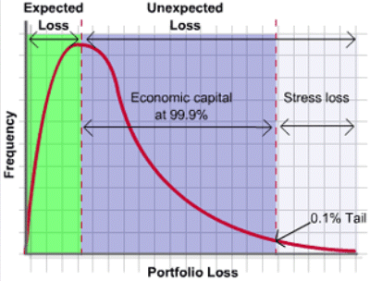
Credit Risk Variables
EL: EL = EAD x PD x LGD
Expected Loss is part of the cost of doing business and it is already included in fees and rates charged by banks.
UL
Unexpected Loss captures the volatility of losses that can go beyond the expected value. It is the maximum loss expected to happen during a certain time horizon and confidence level (Basel II requests a 99.9%). Economic Capital is the cushion that have to absorb that risk.
Assuming a specific model, the value can be calculated such as:

Slide 15
Credit Risk
Measurement

Slide 16
Credit Risk Measurement
Probability of Default (%)
Loss Given Default (%)
Credit Exposures ($)
Counterparty Risk

Slide 17
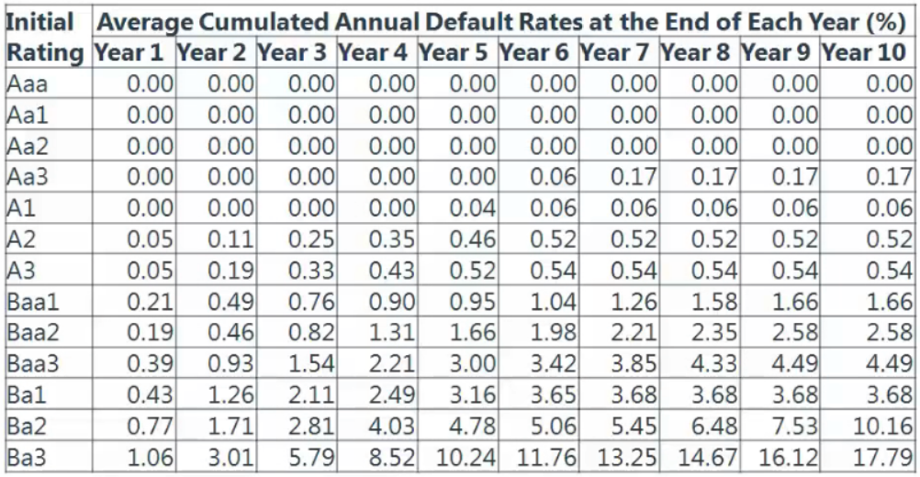
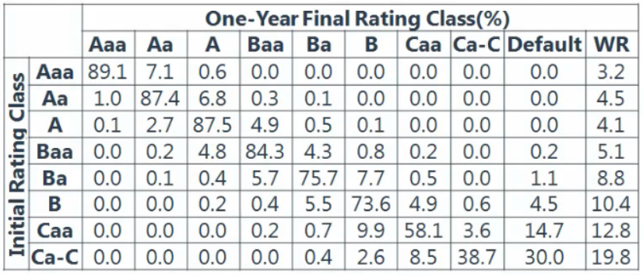
Credit Risk Measurement
Moody From Borrower Ratings to PD
Probability of Default
Rating System
Moody: Only care about issuer rather than issues
S&P: Only care about issues rather than issuer
FITCH: Care about the issues of specific issuer
How the ratings comes out?
From perspective of Rating Agency, three major indicators:
Marginal Probability of Default
Cumulative Probability of Default
Cumulative Survival Rate
Moddy Transition Matrix

Slide 18
Credit Risk Measurement
Probability of Default (Historical)
Infer PD from Bond price
Using Probability of Default and bond price, we can derivative Risk-Neutral PD.
$$Yeild to Maturity −Riskfree rate=PD ∗LGD$$
Maturity – Risk-free rate
Infer PD from Stock Price (Merton Model)
Using Stock price of corporate and make connection between Balance Sheet with Option Valuation(BSM Model)
Asset
($100)
Liability
($80)
Liability:
IF Asset >= 80 THEN Liability = 80
ELSE Liability = Asset
Equity:
IF Asset >= 80 THEN Equity = Asset – 80
ELSE Equity = 0
Corporate:
Max(A – 80, 0)
Option:
Max(S – K)
Equity
($20)
Value of Liability
Value of Equity
PD of (Asset < Liability)

Slide 19
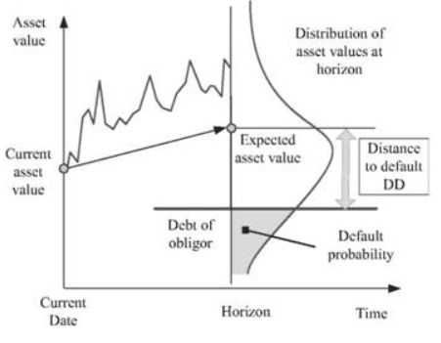
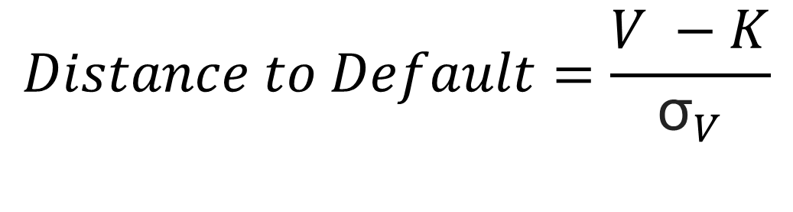
Credit Risk Measurement
Probability of Default (Historical)
Infer PD from Stock Price (Moody’s KMV Model)
Using Distance to default and calculate standard deviation of Asset and Liability.
Case: Enron
$$Distance to Default=\frac{V −K}{{\text{σ}}_{V}}$$
V: Firm value
K: Default threshold
σ: Volatility of firm value

Slide 20
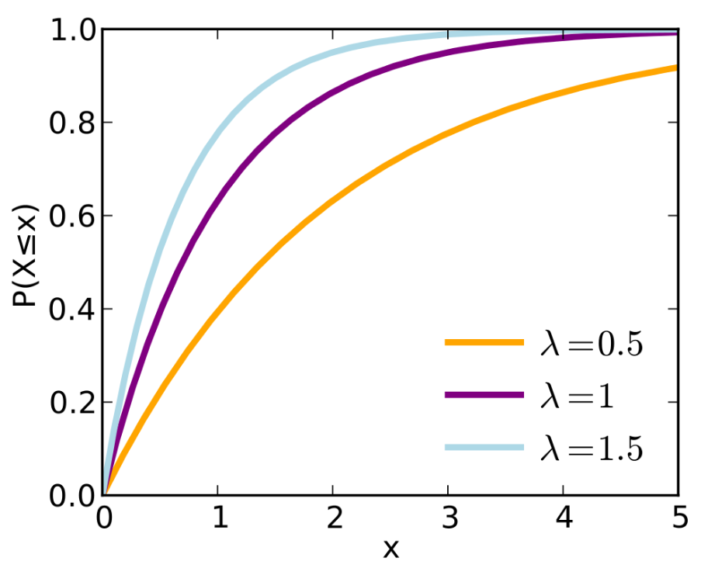
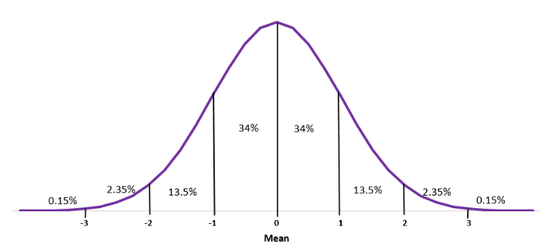
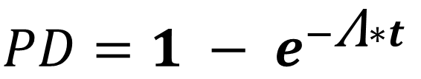
Credit Risk Measurement
Probability of Default (Statistical)
Infer PD from Exponential Distribution
Given condition that we lack information of company, we will use Poisson Distribution and Exponential Distribution to estimate probability of Default.
$$PD=1 − e^{−\text{Λ}∗t}$$
Λ: the rate at which it will taken an event to occur
Infer PD from Single Factor Model
When Default happened?
Economic is poor→ Macro
Firm performance is poor → Micro
Calculate a probability of profit smaller than threshold
(PD = P(Profit <= threshold)
Economic ~ N(0,1)
Firm ~ N(0,1)
Return of Company ~ N(0,1)

Slide 21
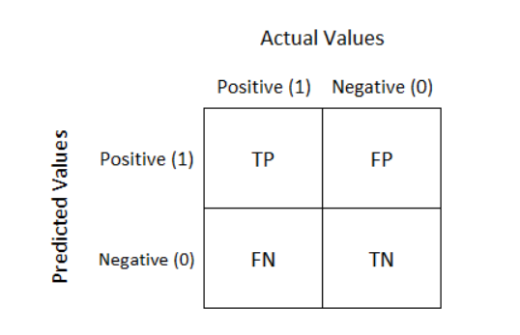
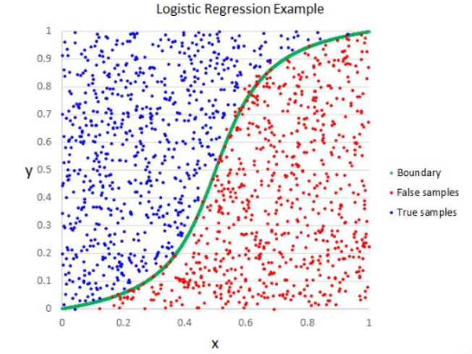
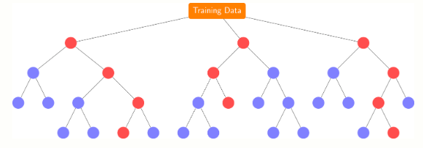

Credit Risk Measurement
Probability of Default (Advanced)
Infer PD from Machine Learning
Logistic Regression
Random Forest
Gradient Boosting Tree
Clustering
Principal Component
…….
Infer PD from Cash Flow Simulation
Infer PD from Linear model
Infer PD from Artificial Intelligence
…….

Slide 22
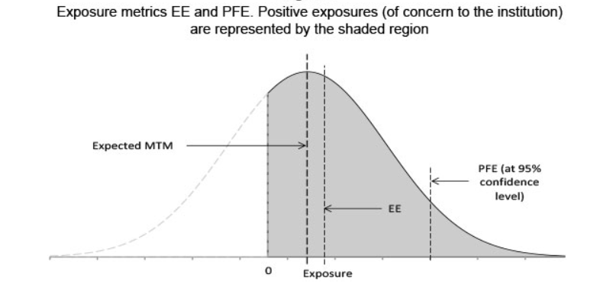
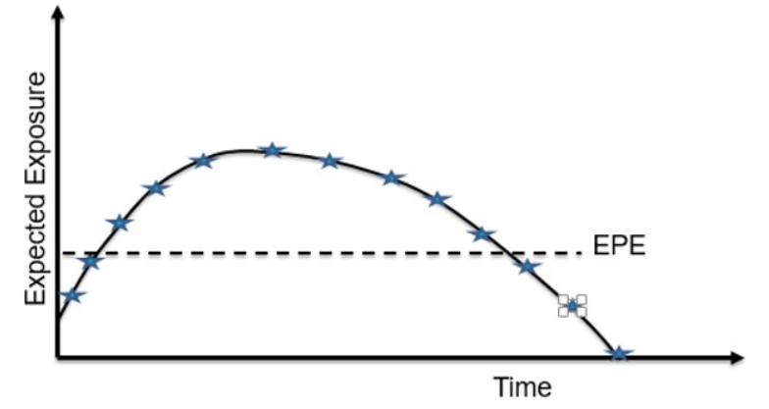
Credit Risk Measurement
Credit Exposures
Exposure Matrix
Exposure: Large of 0 and market value of transaction with netting
Expected Exposure: Average of distribution of exposures
Peak Future Exposure: percentile of distribution of exposures at any particular date
Static
Dynamic

Slide 23
Credit Risk Measurement
Counterparty Risk
Characteristics
Counterparty Risk is conditional risk that NPV of investment is positive, counterparty fails to perform its obligations and there fore no profit is realized from the trade.
OTC Derivatives
Counterparty Risk VS. Lending Risk
Lending Risk: Traditional because business between bank is one-way
Direction is determined
Amount is determined
Date is determined
Counterparty Risk: Contemporary because business between bank is two-way
Direction is not determined
Amount is not determined
Date is not determined

Slide 24
Credit Risk Measurement
Counterparty Risk
No Default Value (NDV)
The value of assets is calculated by condition that both side will not default. This value called NDV.
Credit Value Adjustment (CVA)
From perspective of counterparty’s default.
Difference between risk-free value(No Default Value) and realized value.
Marginal CVA: Break down CVA according to proportion
Incremental CVA: Change in CVA result from a new trade
A
B
Loss = $3
B
A
Loss = $5
Debt Value Adjustment (DVA)
Counterparty risk from point of view of party’s own default.
From view of A: CVA is $5 ; DVA is $3
From view of B: CVA is $3 ; DVA is $5
$$Fair Value=NDV−CVA + DVA$$

Slide 25
Credit Risk Measurement
Stress Testing

Slide 26
Credit Risk
Management

Slide 27
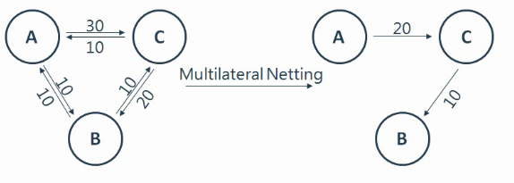
Credit Risk Management
Risk Mitigation
Netting
Provides a gain to both parties as only the net amount of money needs to be paid, reducing counterparty risk
Collateralization
Positive position will require Negative position to post collateral.
Note: Interest, coupon, dividends and any cash flows belong to the owner of collateral

Slide 28


Be Aware of Risk

